Slide 1
Venezuelan Restaurant
In New York City

Slide 2
PURPOSE:
Explore the best locations in New York City for Venezuelan Restaurants
WHY?
New York has seen an increased influx of Venezuelans during the last decade
Increased demand for Venezuelan restaurants

Slide 3
DATA NEEDED:
New York City Data containing the neighborhoods and boroughs
Coordinates (Latitude and Longitude) of these neighborhoods. To plot the data into a map and obtain venue data
Obtain venue data from Foursquare API related to restaurants to determine best locations for a Venezuelan Restaurant.

Slide 4
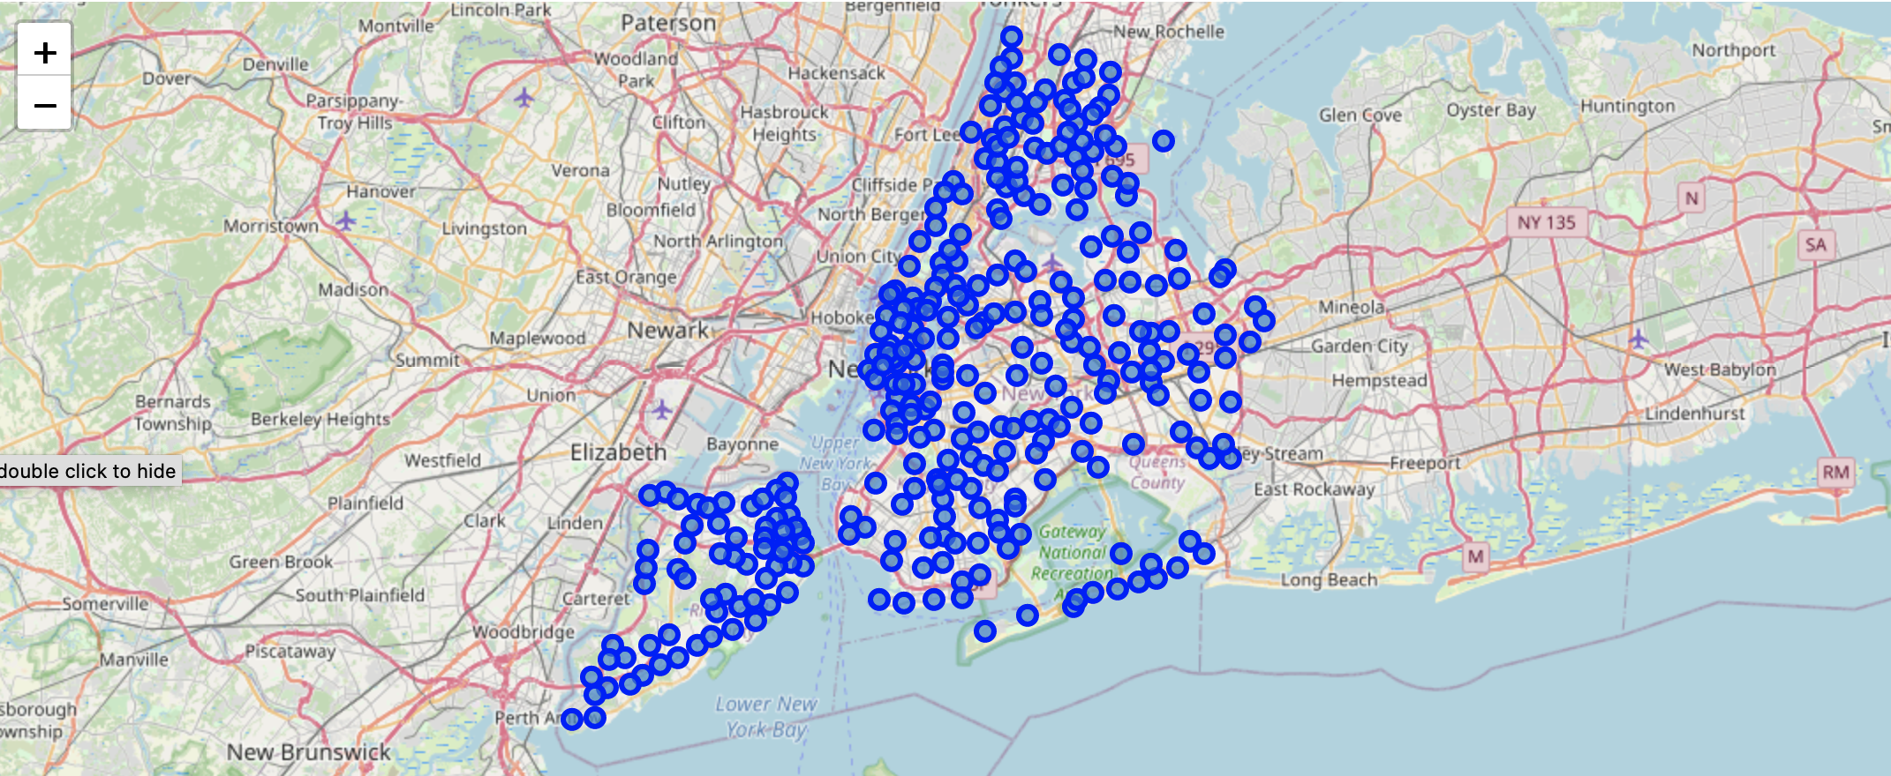
NY BOROUGHS AND NEIGHBORHOODS

Slide 6
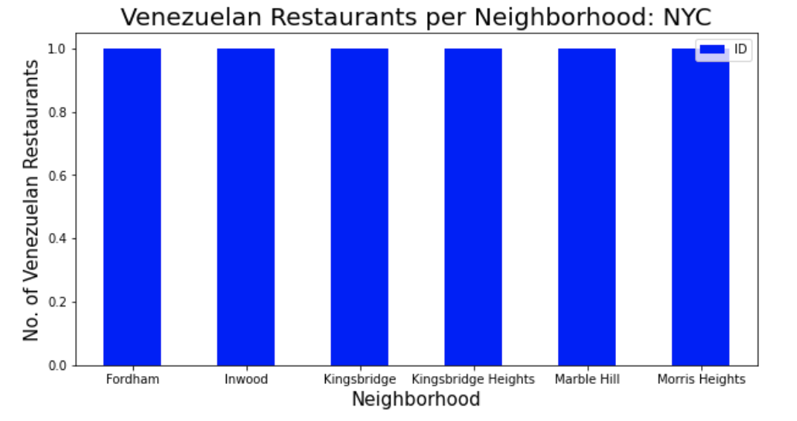

Slide 7
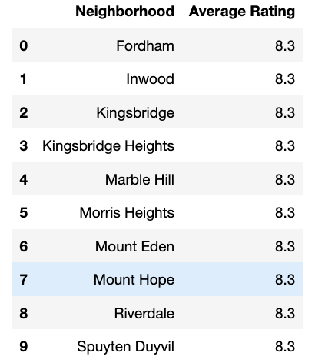
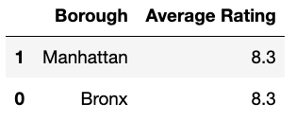
Ratings per Neighborhood and borough

Slide 8
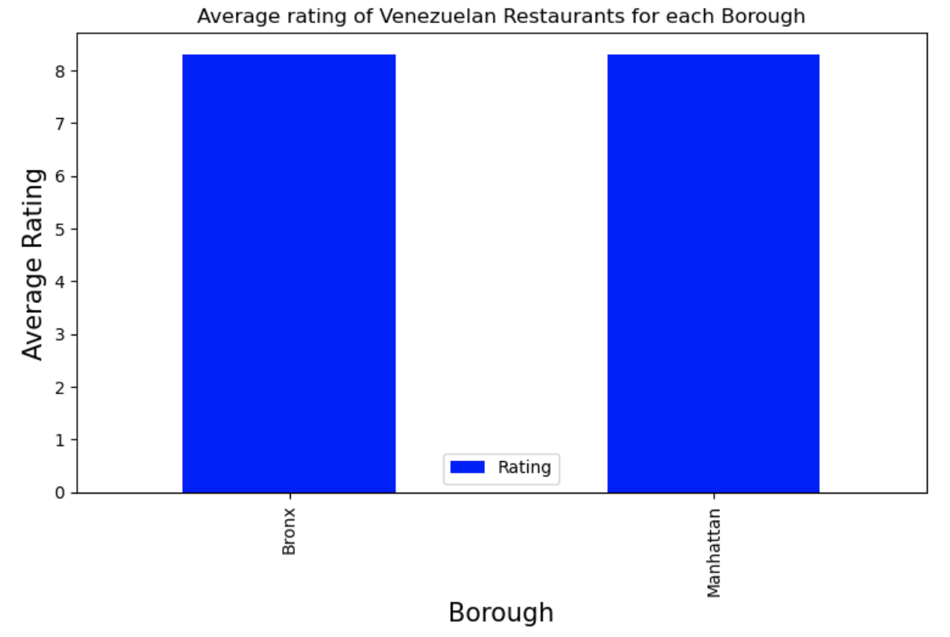

Slide 9
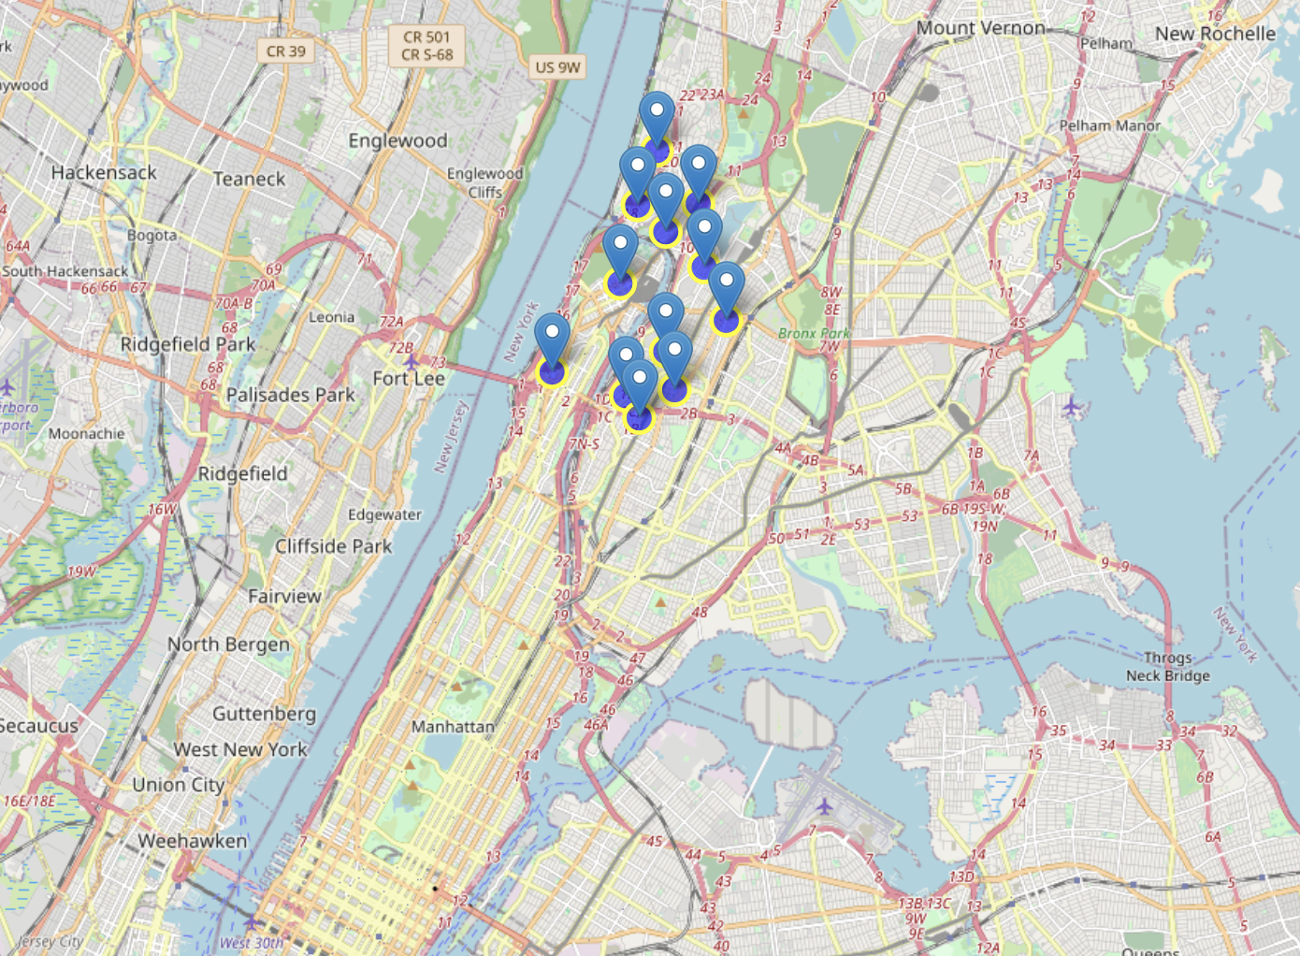
Venezuelan Restaurants in NYC

Slide 10
Bronx & Manhattan
Are the best locations for a Venezuelan Restaurant

Slide 11
THE END

